Slide 1
Travel Book
TLEN 5839, Alimulla Shaik.

Slide 2
Agenda
Introduction
Design
Security
Features
Demo

Slide 3
Introduction
People travel around the world but no application available to share their experiences.
No app present to suggest places to the users based on their preferences.
Developed a system to recommend travel places to the user.
Users can share their travel experiences and rate the places.

Slide 4
Design
Home Page
User Profile
Travel Feedback Page
Login
Share Experience
SignUp
Search for Places
SignUp Page
Name
Places Search Page
Email
Database
Password

Slide 5
Security
Used authentication to validate users and restricted all the features.
Sessions are used store information across multiple pages.
Maintained users data in relational database and passwords are encrypted using sha.
Prevented SQLi attacks using prepared statements.
To improve security further redirected all the pages using HTTPS.
Sanitized the user inputs and information using htmlspecialchars() and strip_tags().

Slide 6
Features
Users can signup to access all the functionalities of this application.
Email id is good for one account only to prevent duplicate account creation.
Once account is created, users can share their travel experiences or rate the places they visited.
Users can look for the places by providing country or place type like hiking or scenery etc.
Users can update password easily and can logout from any point.
Admin user can view all the incorrect login attempts for this application and all the user information who tried to access.

Slide 7
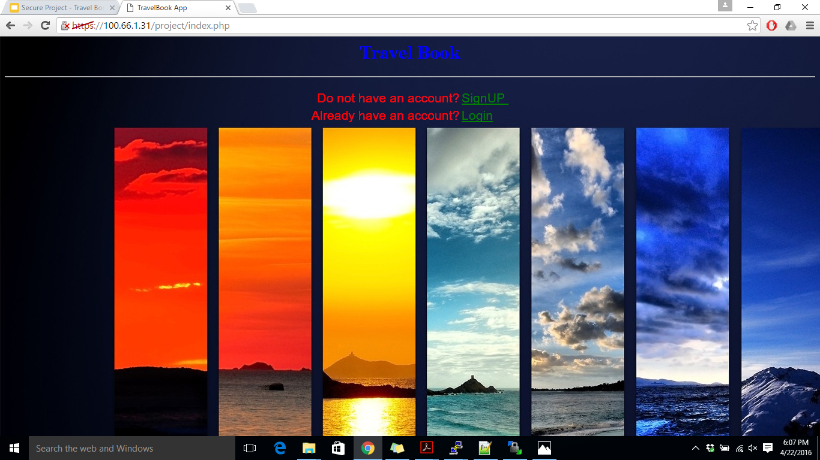
Demo
Home Page:

Slide 8
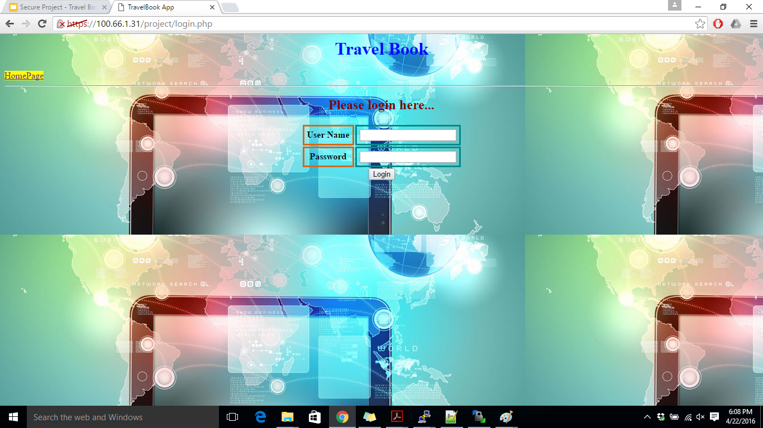
Login Page

Slide 9
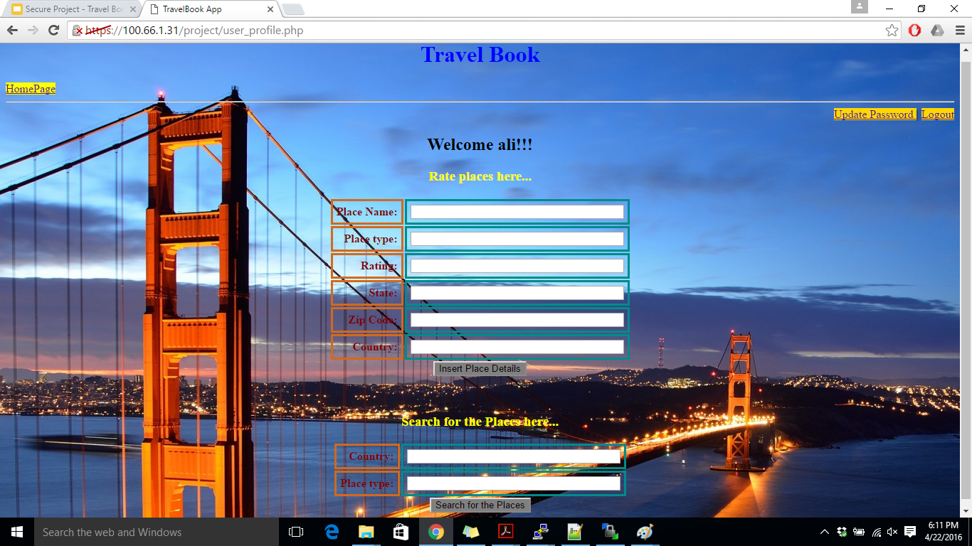
User Profile Page

Slide 10
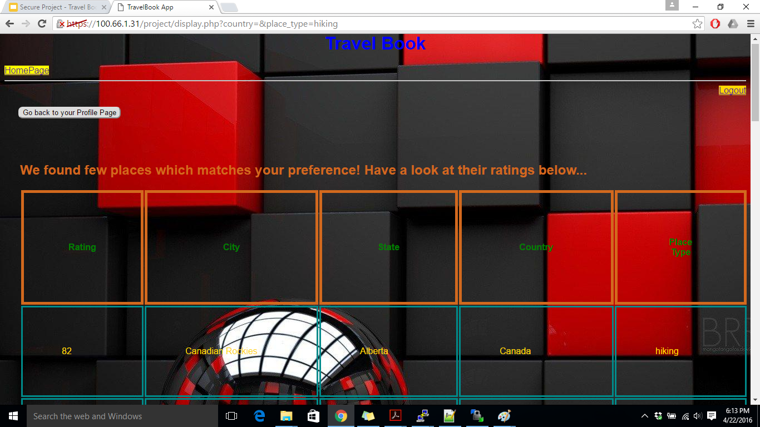
Results Page

Slide 11
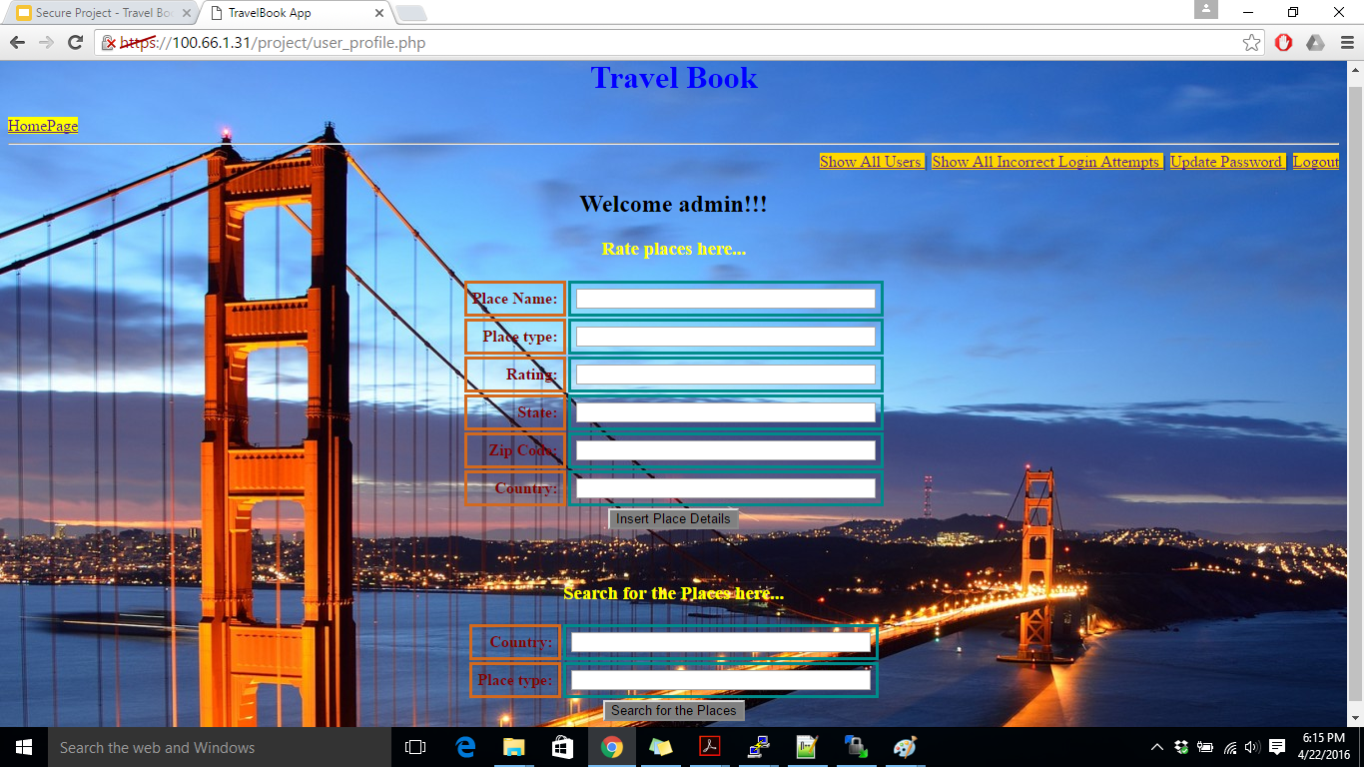
Admin Page

Slide 12
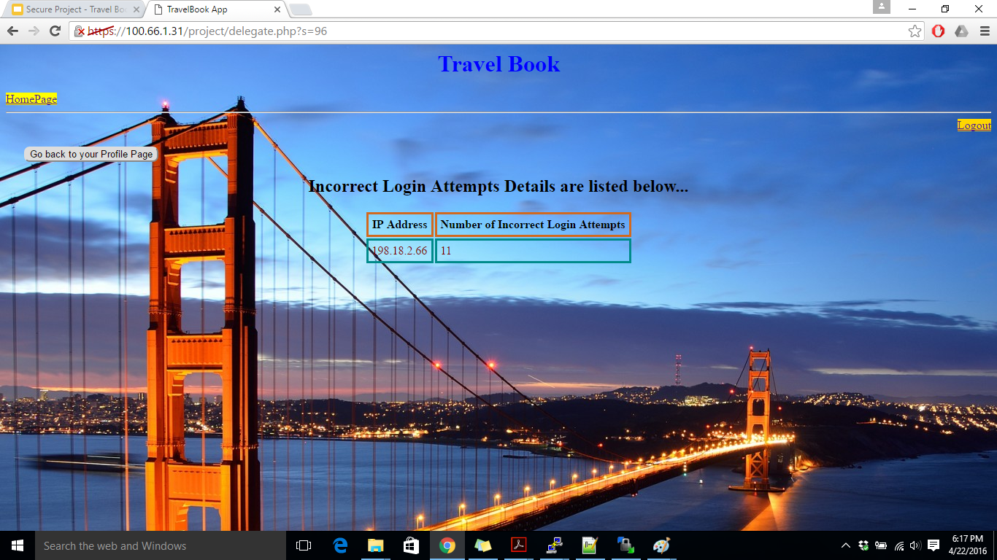
Admin can view incorrect login attempts

Slide 13
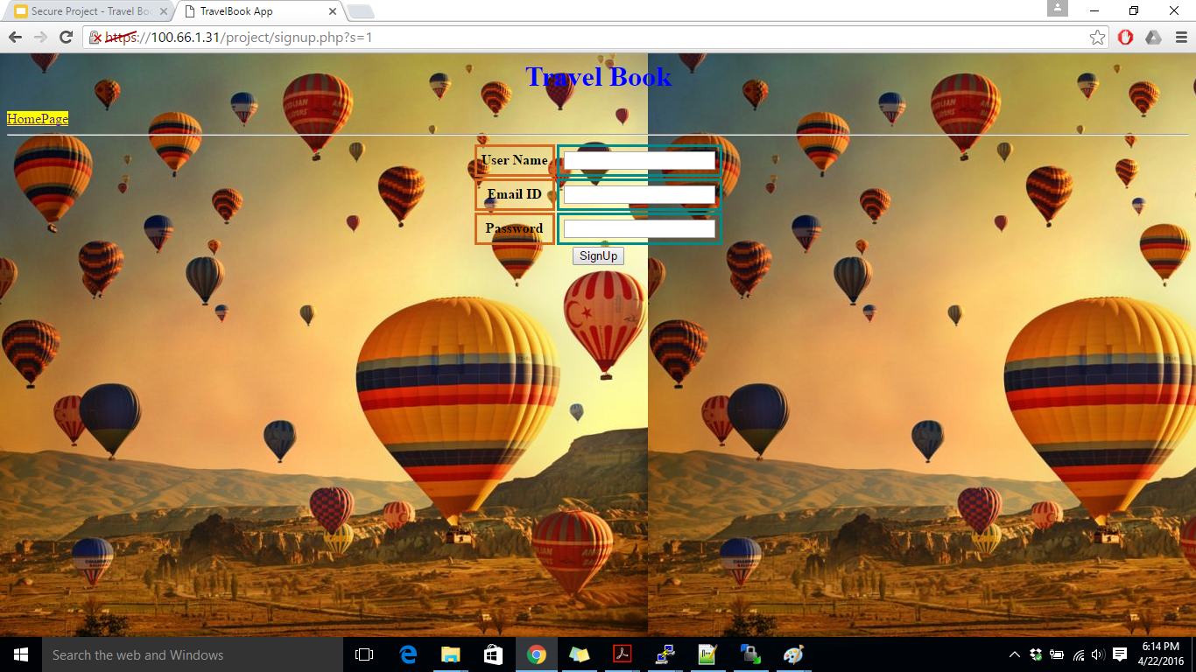
Sign Up Page

